Slide 1
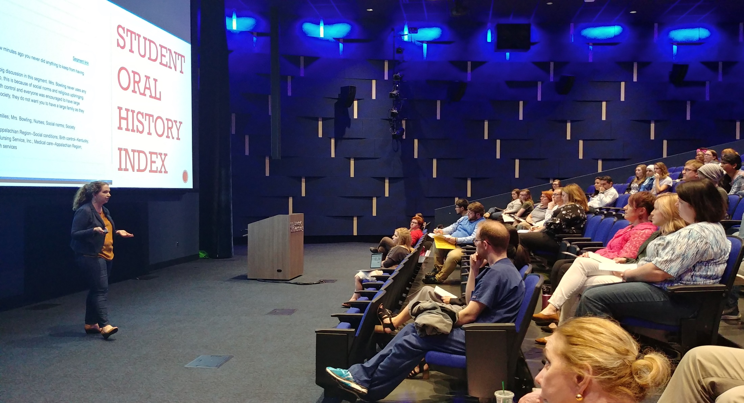
UK GradTeach Live!
Communicating Your Teaching Philosophy

Slide 2
Origins of UK GradTeach Live!
Recognize the importance of teaching as a core component of graduate student professional development

Slide 3
Goal 1: Communication and Articulation of Teaching Philosophy
Communicate
Clearly communicate elements of teaching philosophy
Describe
Describe how the particular philosophy advances learning
Articulate
Articulate value of the teaching philosophy

Slide 4
Goal 2: Teaching Philosophy in Practice
Illustrate with an engaging classroom example
Relate example to teaching philosophy
Avoid disciplinary or educational jargon
Inspire curiosity to know more

Slide 5
Goal 3: Effective communication
Enthusiasm for teaching
Stage presence, pacing, eye contact, and confidence
Adequate time spent on philosophy and example
Clear and legible slide

Slide 6
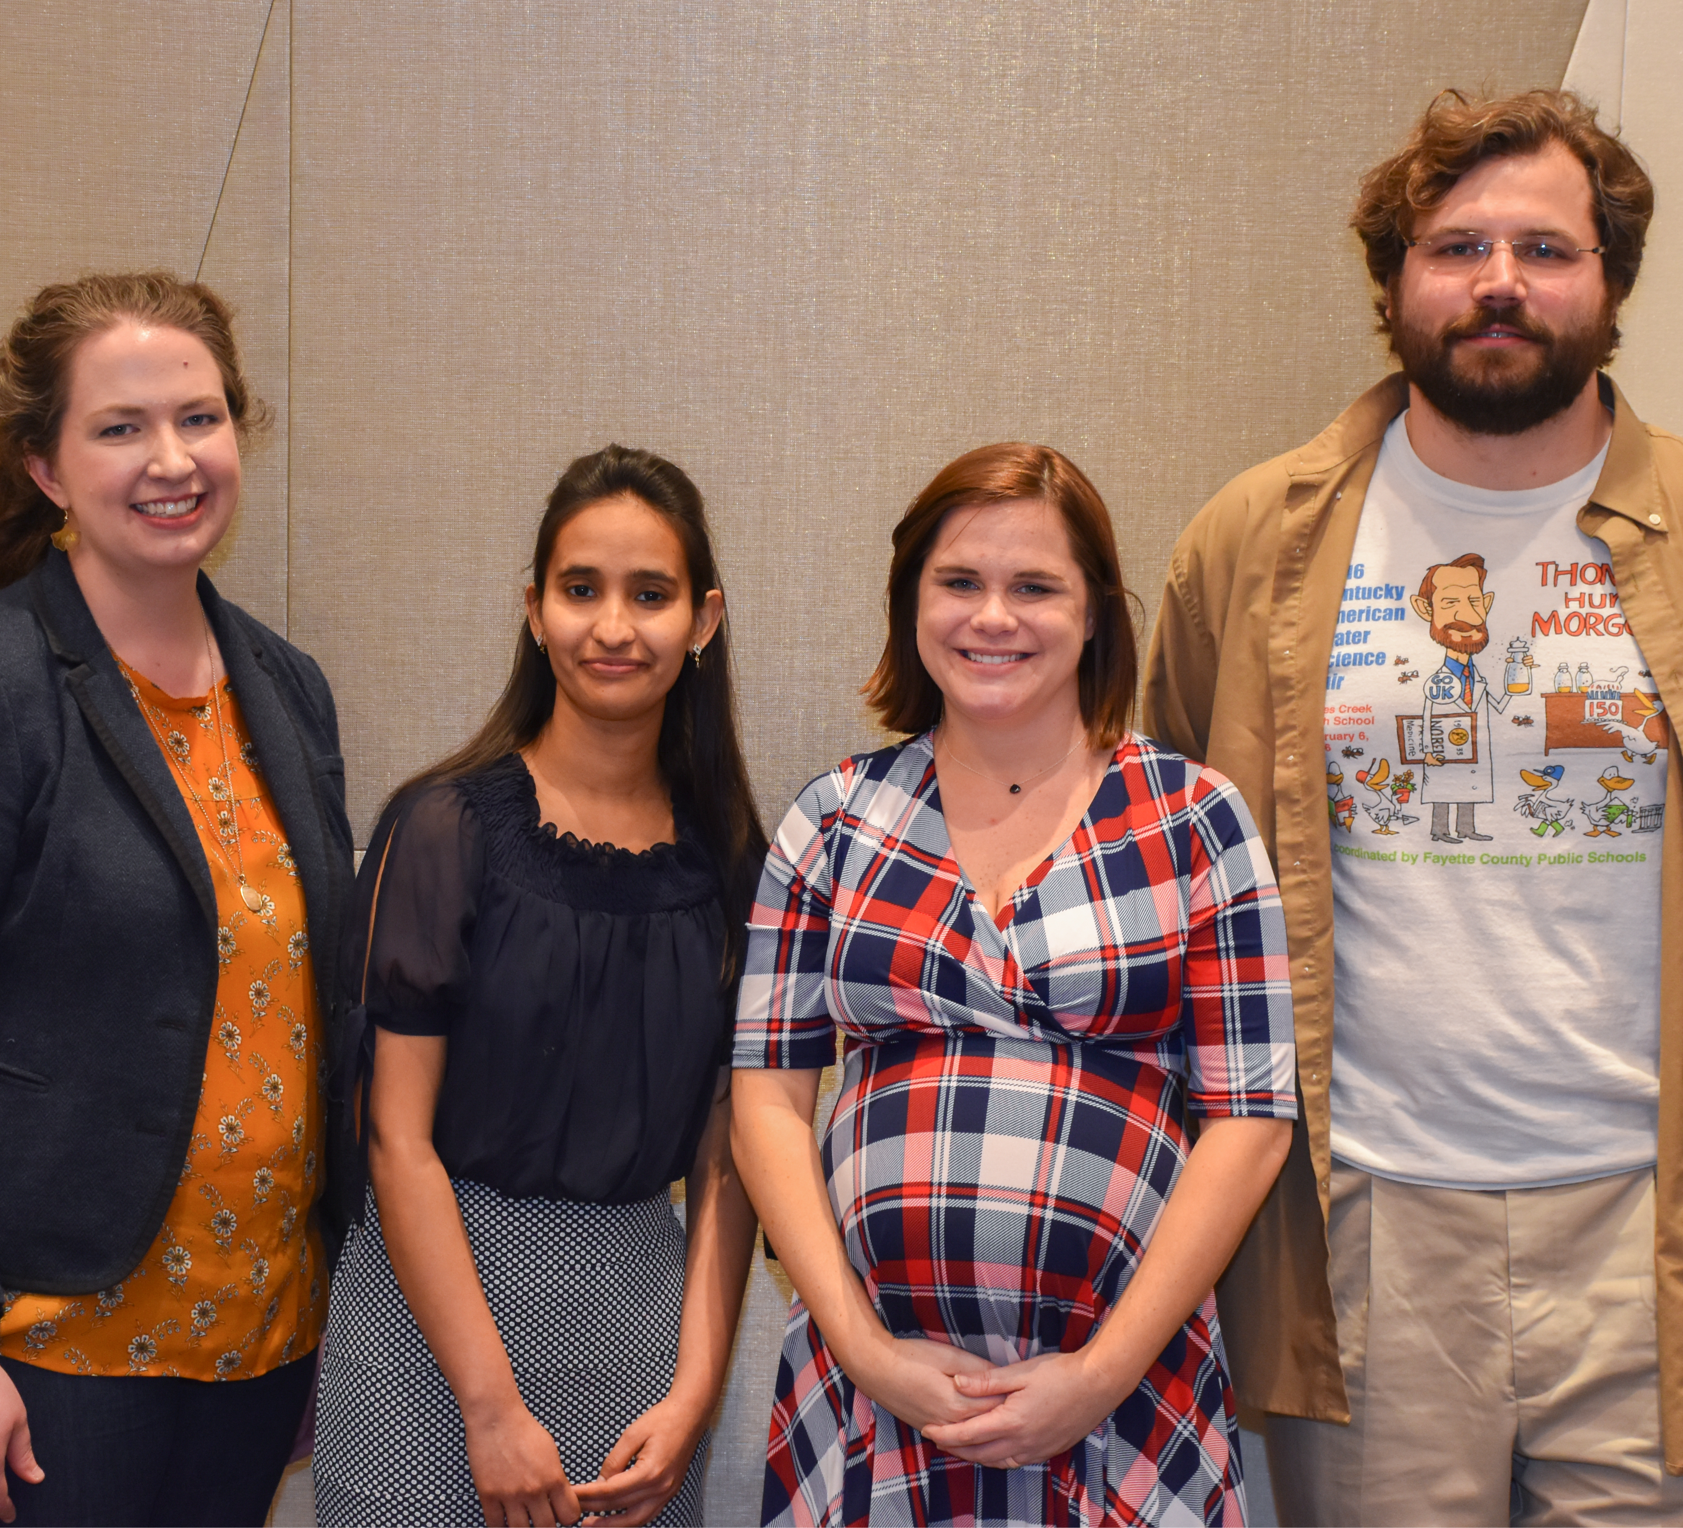
UK GradTeach Live! 2019 Winners
“As graduate instructors, we don’t always have a lot of venues in which to share our pedagogical work with a large audience. GradTeach Live! gave me not only the opportunity to do just that, but also to reflect on and think deeply about my pedagogy and how to clearly and quickly articulate it in ways that I know will serve me well on the job market. Additionally, it allowed me to connect with other instructors across campus who are passionate about pedagogy and to learn from them and their innovative approaches – something else we so rarely get the opportunity to do but that is so vital to continuing to develop our own pedagogy!”
— Jannell McConnell Parsons, 2019 GTL! Winner

Slide 7
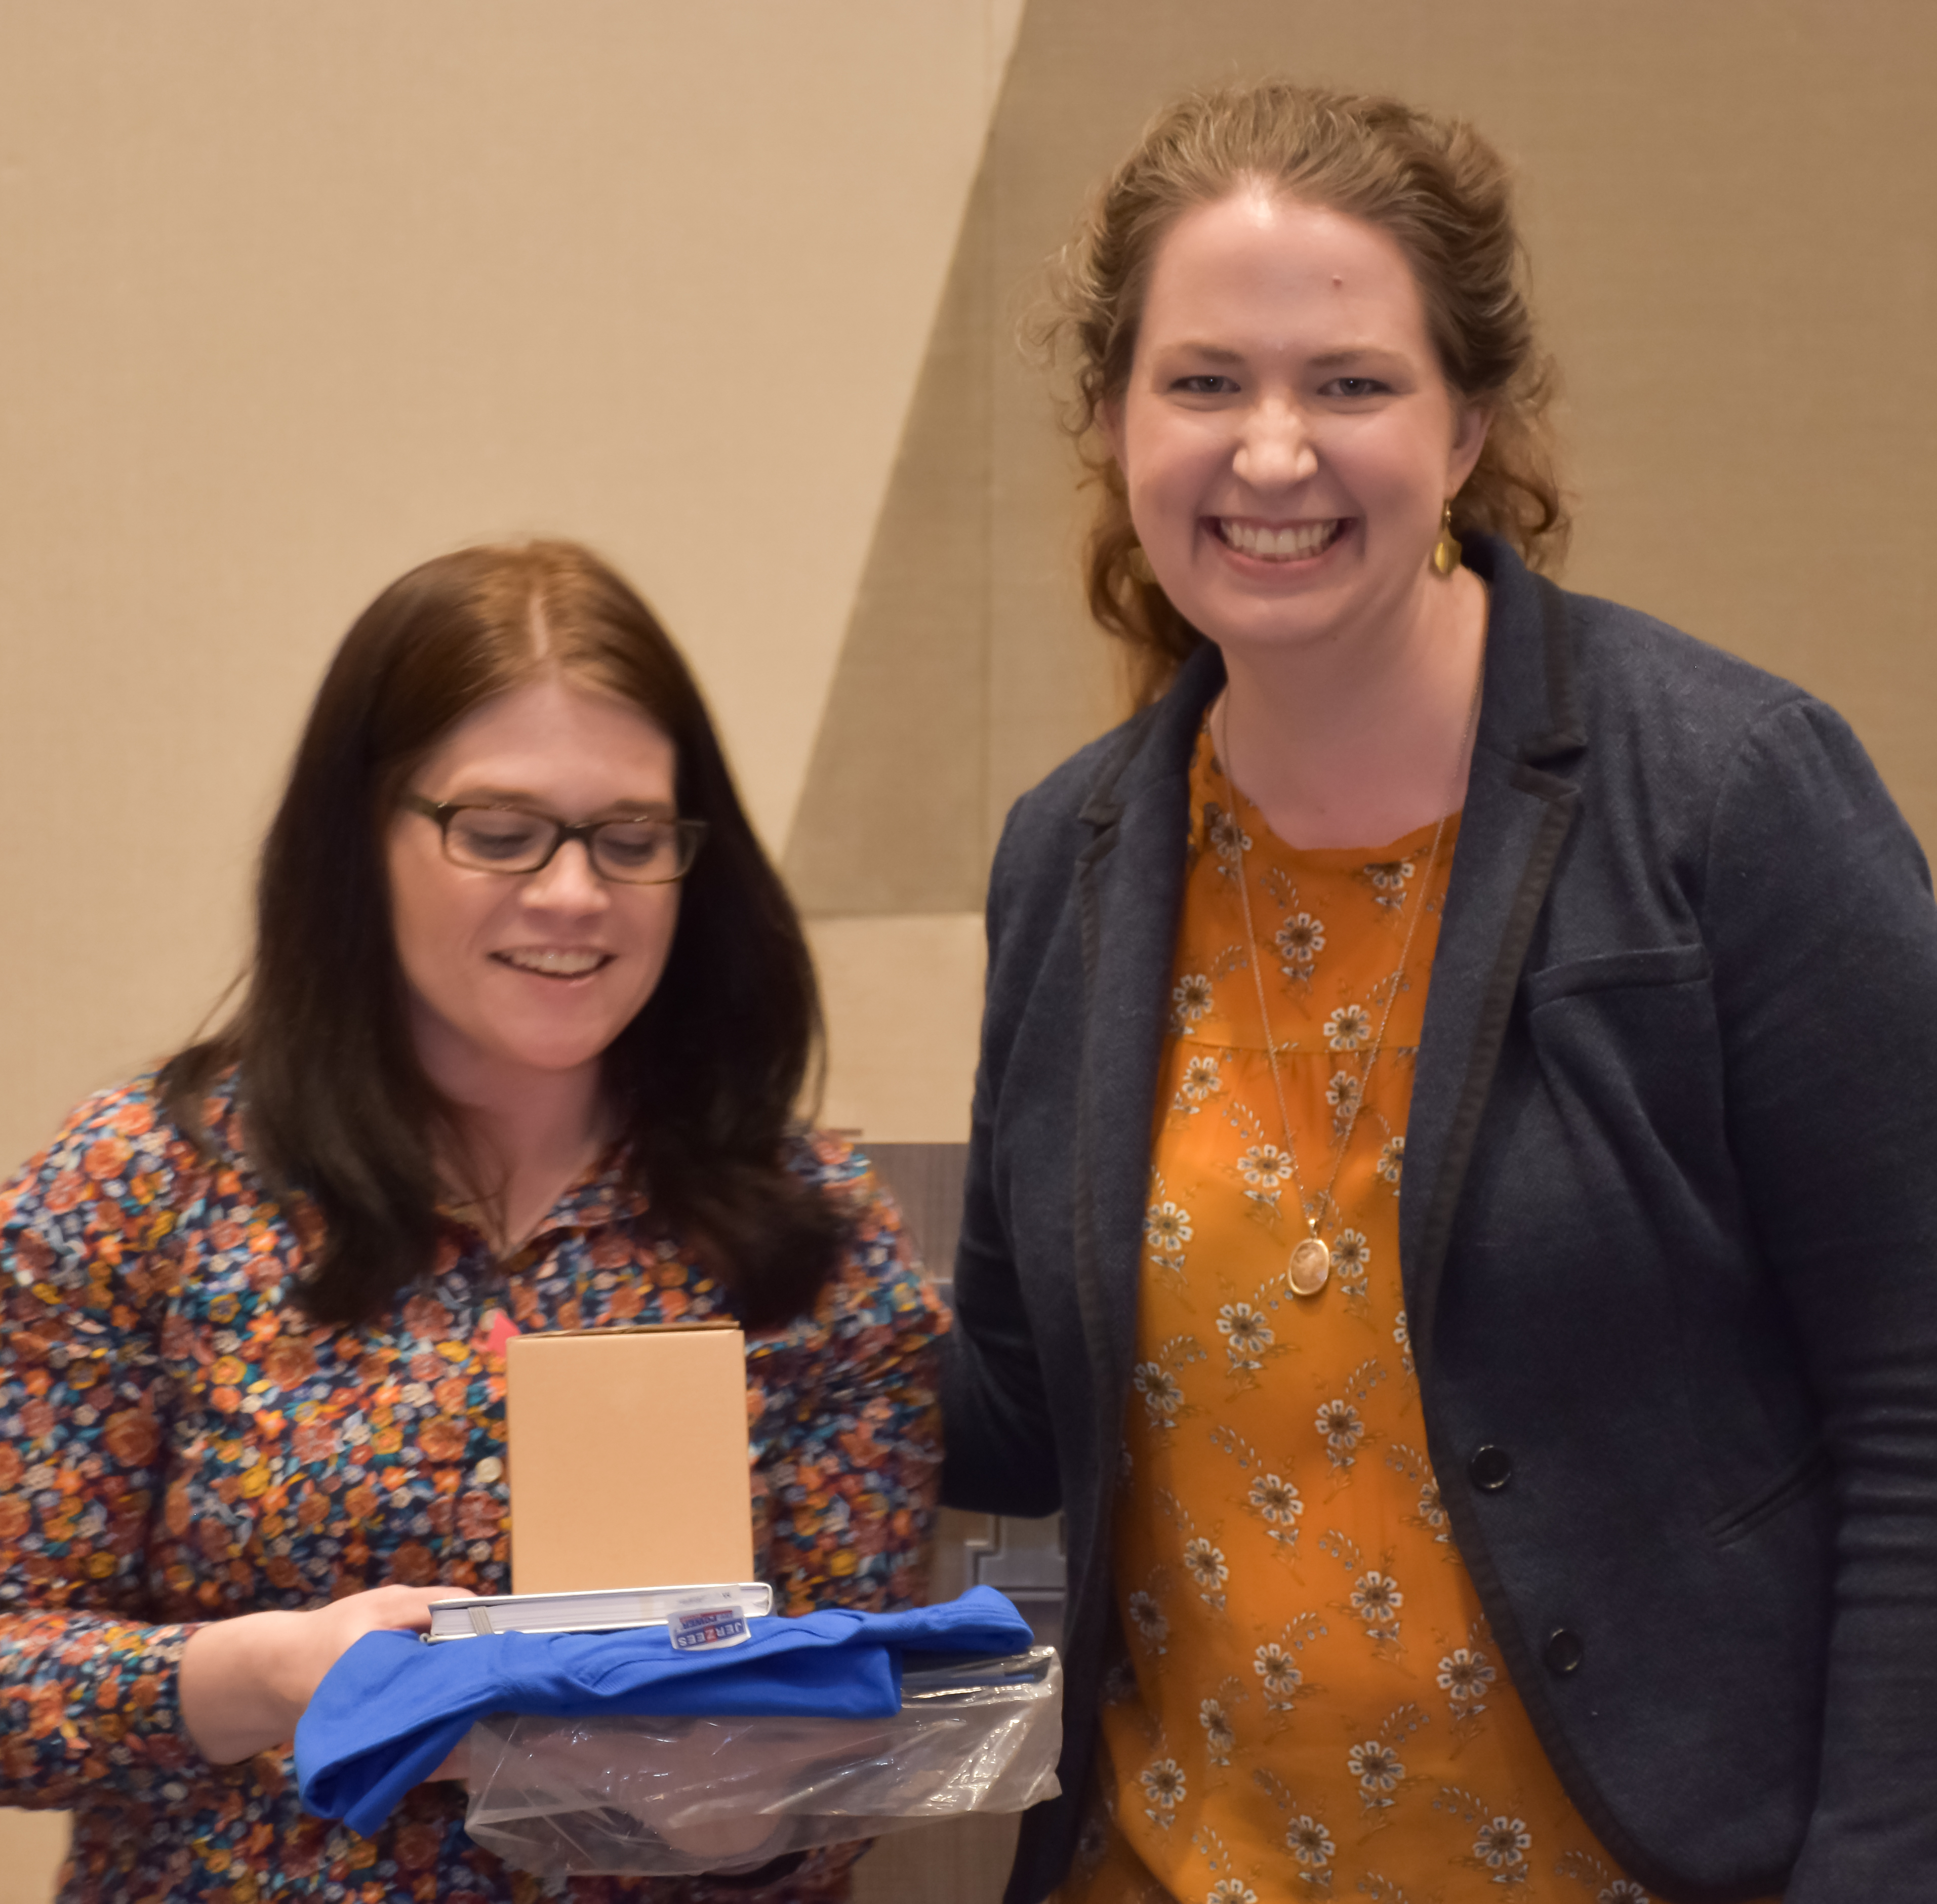
Monetary Prizes!
1st Place: $750
2nd Place: $500
3rd Place: $250
People’s Choice: $250

Slide 8
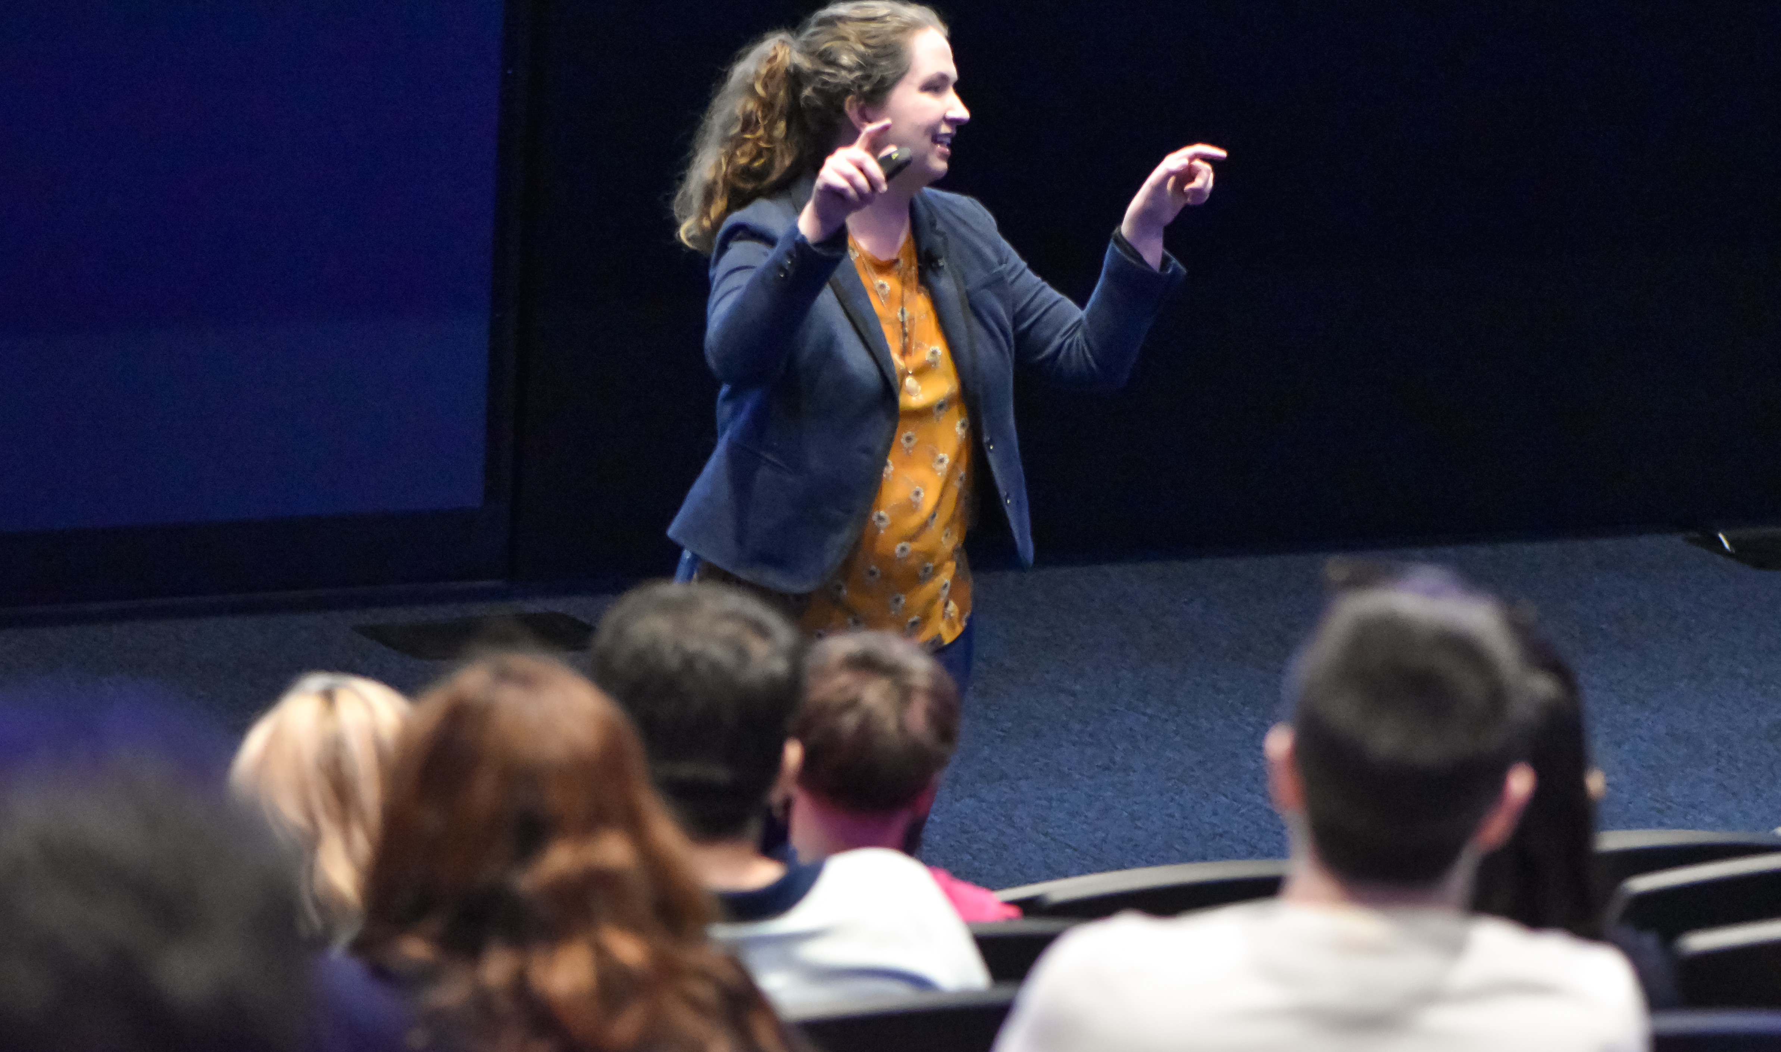
Tell Your Teaching Story
Part of the storytelling ability is simply the anticipation of boredom and the introduction of a sudden surprise.

Slide 9
Show Your Teaching

Slide 15
Workshopping your Statement

Slide 16
Important Dates
Preliminary Round (12 move on to finals):
March 24, 4:30 p.m.-6:30 p.m.
Humanities/Social Sciences in Taylor Auditorium (Taylor Education Building)
STEM in UKAA Auditorium (Young Library)
Finals
April 7, 4:30 p.m.-6:30 p.m. in Worsham Cinema (Gatton Student Center)
Reception to follow

