Slide 1
Communicating Your Research
to a General Audience
Basic Principles & Reminders
with an introduction to
UK’s GradResearch Live!

Slide 2
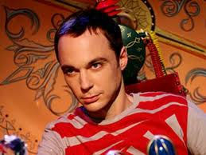
Grappling with the curse
of knowledge
When you know something so well, it’s difficult to imagine what it’s like not to know it.
The Big Bang Theory

Slide 3
Presenting Your Research to Novice Audiences
Build a case for why your research matters
Minimize or eliminate academic jargon
Use narrative cues to help the audience
Use images to support and concretize your central findings/assertions
Be conversational and expressive

Slide 4
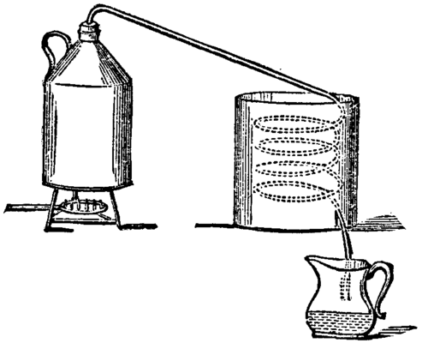
Finding and Distilling Your Research Story

Slide 5
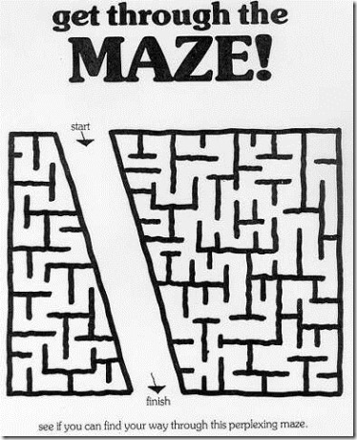
Distilling does not mean “dumbing down”
Rather, it places the focus on meaning, less on process.

Slide 6
Carefully Craft and Deliver Your Story
In oral presentation, a good story is easy for you
to remember and tell.
A good story is also easy for your audience
to follow and recall.

Slide 7
Needs a beginning, middle, and ending
Find your “hook.” Engage your listener in your story;
  then introduce complexity gradually.
Avoid the abstract; use examples, anecdotes, analogies to help appeal to the senses (especially
the visual)
Build suspense – what’s surprising, exciting, difficult, upsetting, mysterious about your topic?
Return at the end to your hook and also leave the
audience with an idea or image to ponder.

Slide 8
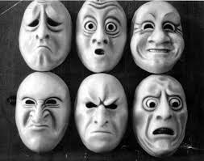

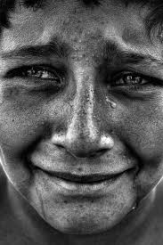
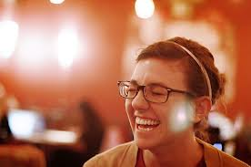
Appeal to logic and emotion
Don’t be afraid to show your passion or get personal.

Slide 9
Why is distilling and communicating research to non-specialist audiences important?
  Ignites excitement about your research beyond your committee and department.
  Engages the public, the media, legislators, and potential funders in your research and scholarship
  Creates and empowers an informed citizenry
  Potentially improves state and federal support for higher education and research

Slide 10
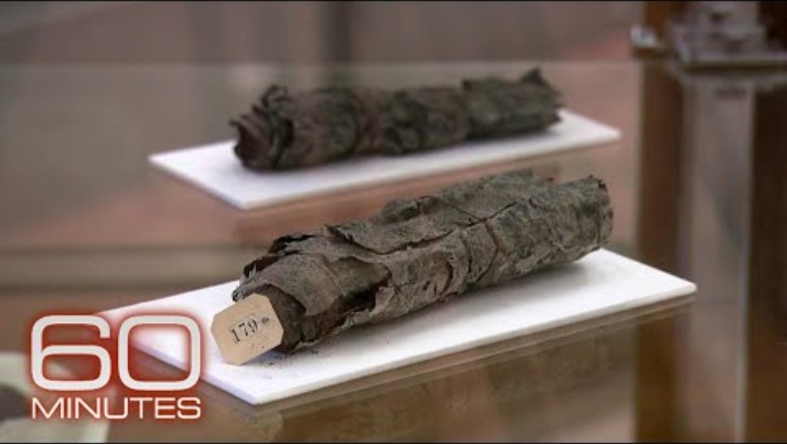

Slide 11

Sponsored by The UK Graduate School

Slide 12

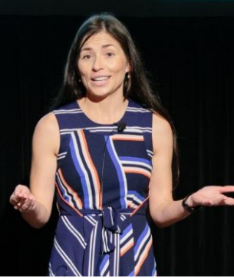
UK GradResearch Live! was born out of the University of Queensland’s 3-Minute Thesis (3MT) competition, a research presentation initiative that challenges graduate students to communicate their research concisely and engagingly to a general audience with a single slide in three minutes.

Slide 13
UK GradResearch Live!
Two Tracks:
Pre-3MT (Early in the Research Project)
3MT (Nearing Completion of the Research Project)
Timeline:
Video submission deadline – 8am on Monday, 10/20/25
Final Event – 5pm on Wednesday, 11/5/25
Prizes:
3MT
  First Place - $750
  Second Place - $500
  Third Place & People’s Choice - $250
Pre-3MT
  First Place - $500
  Second Place - $250
  Third Place & People’s Choice - $150

Slide 14
How can the 3MT benefit you?
Develops your communication and presentation skills to non-specialist audiences
Highlights important and innovative research that most of us do not hear about
Fosters creativity in constructing your research story and design of your slide
Allows for networking with other students, faculty, staff
Gives you an edge in the job search (or postdoc search)
Prize money!

Slide 15
Your presentation TITLE is critical
Try to keep it under 8 words.
Keep it fun.
Think of it as a newspaper headline or an article teaser, not as an academic journal title.
Example (from Matthew Thompson, University of Queensland)
Dissertation title: “Structures and Features in Complex Visual Stimuli Assisting Identification in Forensics”
3MT Title: “Suspects, Science, and CSI”

Slide 16
How to Support your Research story
with a Single Slide?
Think of your slide as the background for your presentation
Make it simple and quickly decipherable, like a billboard.
Choose your fonts wisely and limit use to one or two fonts at most.
Use high-quality images, and don’t stretch, squeeze, or warp them.
Establish a visual hierarchy, like a stylistic form of punctuation to help viewers quickly digest the information
Put some thought into your color scheme, or, better yet, use a design assistant
Leave off logos, sponsors, and affiliations
Don’t forget about negative space!

Slide 17
Additional Resources:
University of Queensland’s 3MT site
https://threeminutethesis.uq.edu.au/watch-3mt
University of Kentucky’s previous competitions
https://gradschool.uky.edu/uk-gradresearch-live

Slide 18
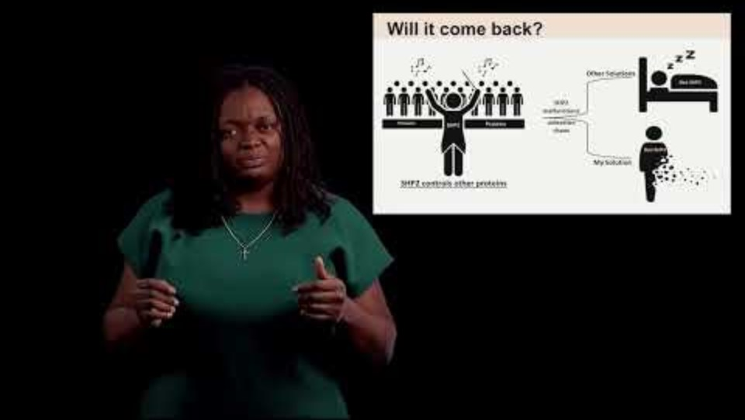

Slide 19
Q&A Session
Pegah Savafi – Winner of 2024 GradResearch Live! and regional representative
Abhilash Prabhat – Winner of 2025 Postdoc Slam Competition

