Slide 1
FULBRIGHT-HAYS DOCTORAL DISSERTATION ABROAD (84.022A) G5 APPLICATION SUBMISSION OVERVIEW FOR A FELLOW

Slide 2
G5 USER REGISTRATION

Slide 3
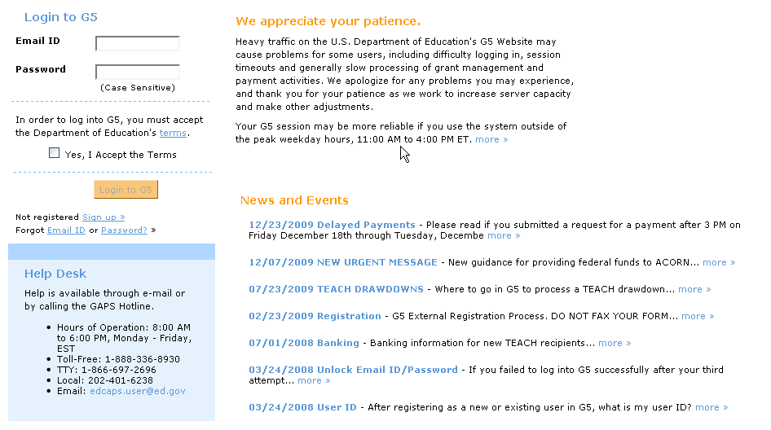
Section A: Registration/Login Pgs.3-13
Step 1: Registering with G5
To register go to www.g5.gov and click the Sign up > link. The image displays the G5 Welcome Page and has an arrow pointing at the Sign Up link which moves the user to the next screen for registration.

Slide 4
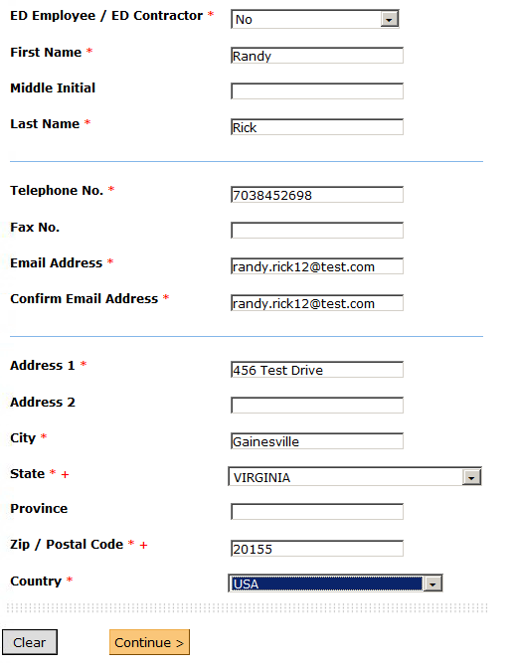
The Sign up > link brings you to the User Registration screen. This screen requires you to enter the fields marked by a red asterisk. The telephone and fax number must be ten numbers only. You must register with a valid email address in order to receive the activation link for your account. When you have finished completing the form click the Continue button.
Step 1: Registering with G5

Slide 5
Step 1: Registering with G5
The Summary screen allows you to review and verify the information entered. If you agree to the terms listed in orange, select the Agree radio button and click the Submit button.

Slide 6
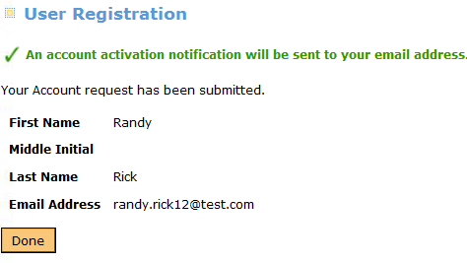
Step 1: Registering with G5
You will then see a Confirmation screen like the one above.
Please note that a link will be emailed to you at the email address you provided.

Slide 7
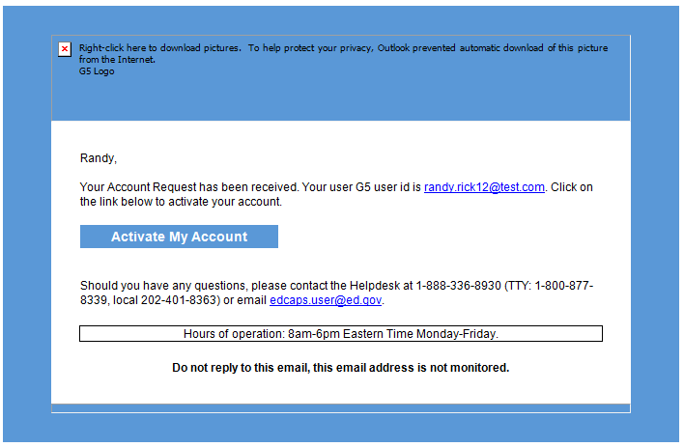
Step 2: Activating Your Account
Shortly after you register you will receive an email message similar to the one below. Click the link and it will take you to G5 to activate your account.
Please note depending on your email provider, the link may be re-formatted. If clicking on the link directly does not work, you can try copying the entire link and pasting it into your browser.

Slide 8
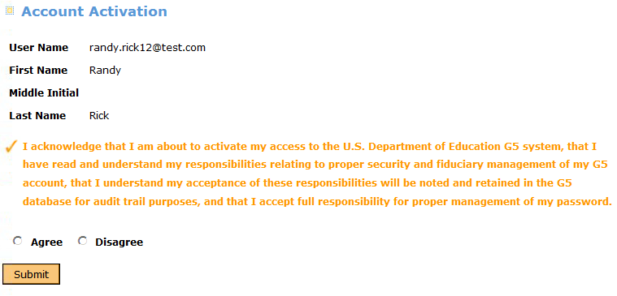
Step 2: Activating Your Account
The link in your email will bring you to the Account Activation screen. Please read the user agreement, click the Agree radio button to acknowledge your compliance, and click the Submit button.

Slide 9
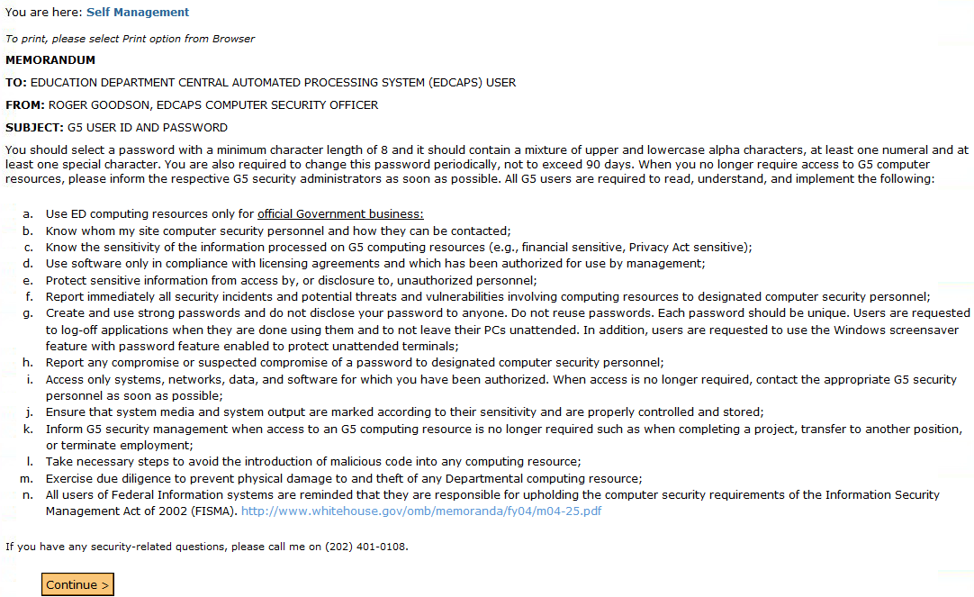
Step 2: Activating Your Account
Read the G5 User ID and Password Memorandum and click the Continue button.

Slide 10
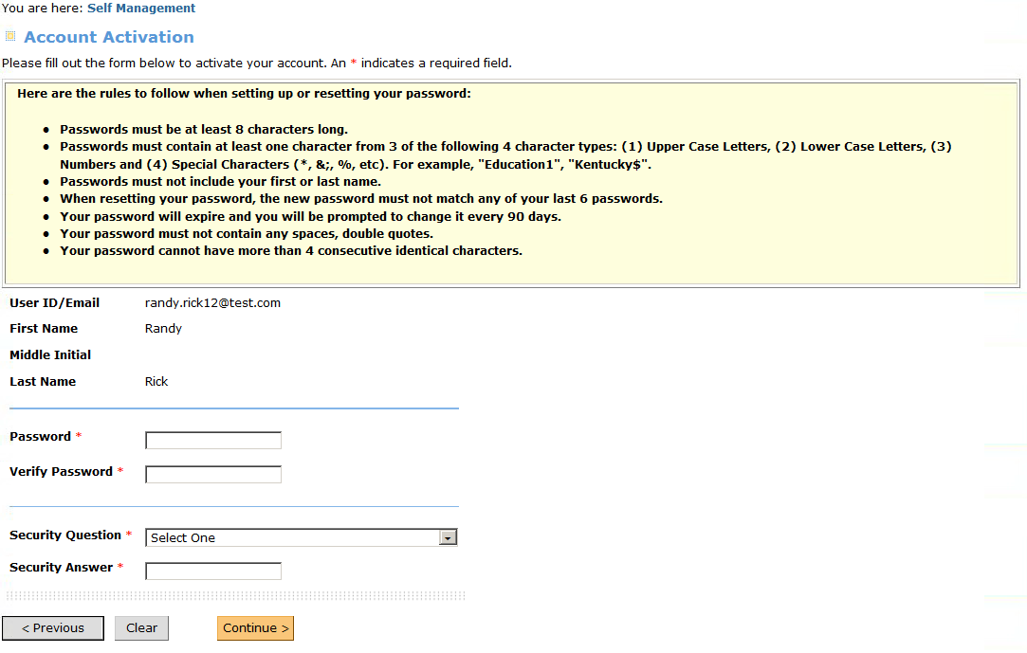
Next you will see the screen above. Enter the required fields and click the Continue button to finalize your activation.
Step 2: Activating Your Account

Slide 11
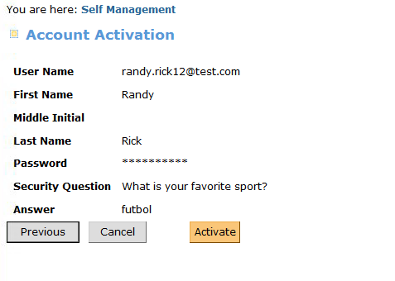
Click the Activate button to confirm the information you have entered and activate your account.
Step 2: Activating Your Account

Slide 12
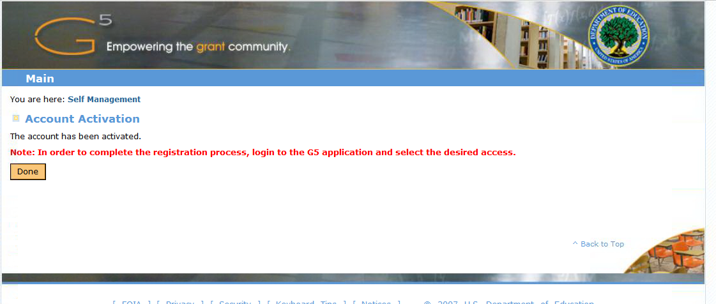
This screen tells you that your account is now activated. By default, you will be granted the applicant role. The system will also send you an email confirming that your account has been activated. The email will include a link to the G5 web page where you can log in using the password you just created.
Step 2: Activating Your Account

Slide 13
INITIATING AN APPLICATION FOR A Fellow

Slide 14
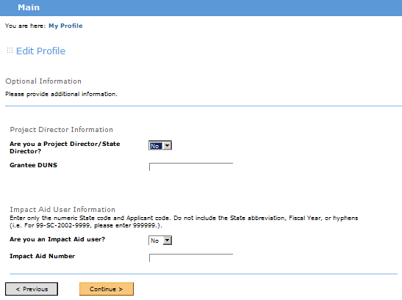
Logging in as a Fellow
A Fellow registering in G5 for the first time will be prompted to update
their profile after they initiate the log in activation link. They MUST select NO when asked
“Are you a Project Director / State Director?”

Slide 15
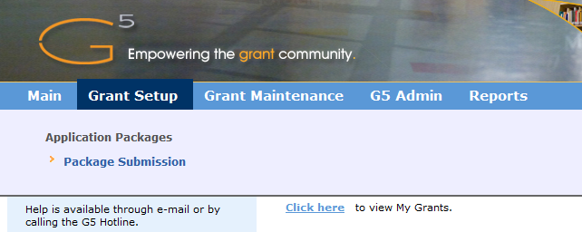
A list of applications in progress can be viewed by selecting “Package Submission” from the Grant Setup header

Slide 16
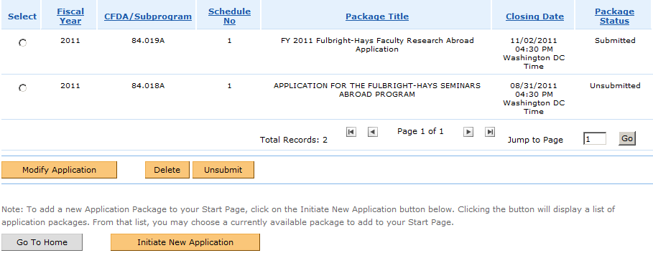
To start a new package users should select the Initiate a New Application button
Applications in progress are listed in the Application Packages screen shown below
Here you can Modify, Delete, Submit /Unsubmit or Initiate applications

Slide 17
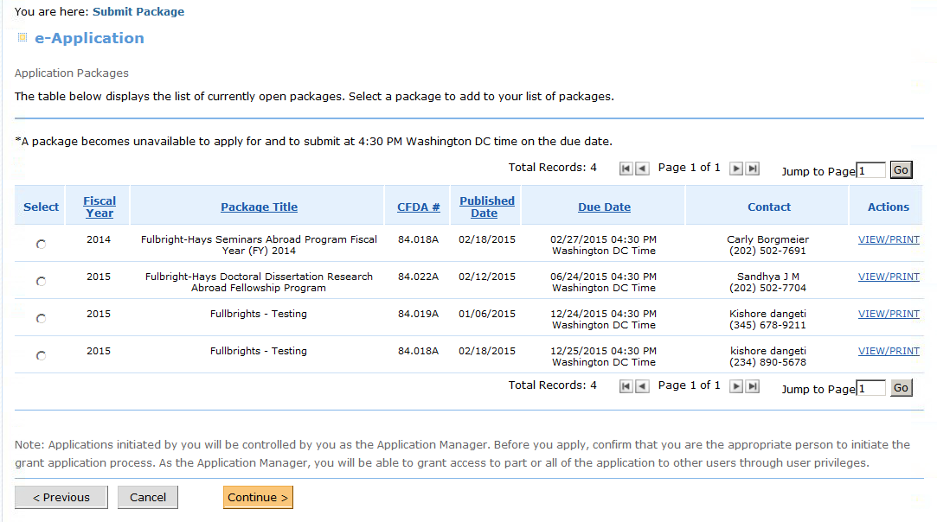
Selecting “Initiate New Package” will populate all of the available applications. After selecting
The 84.022 package radio button, the user will be prompted with a question.

Slide 18
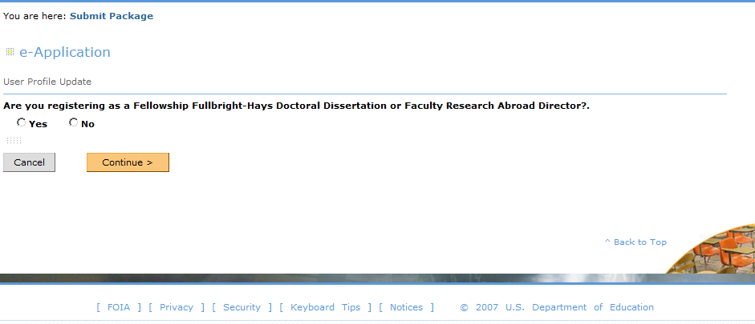
The Fellow must select NO to this question: “Are you registering as a
Fellowship Fulbright – Hays Doctoral Dissertation or Faculty Abroad Director?”
(The Project Director must select YES when asked this question)

Slide 19
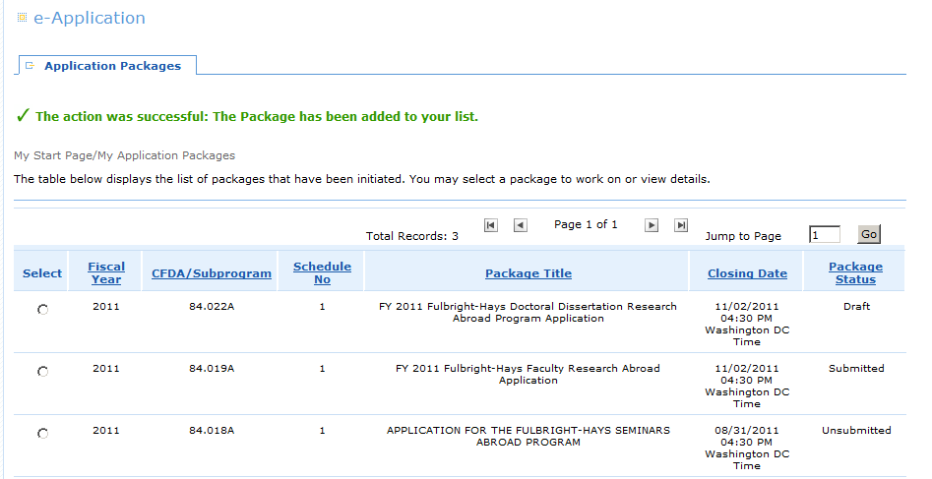
The selected application will be added to the package list

Slide 20
Once applications have been added you can alternatively view Application Packages, by selecting “Click Here” to view My Applications from the Home Page after logging in.

Slide 21
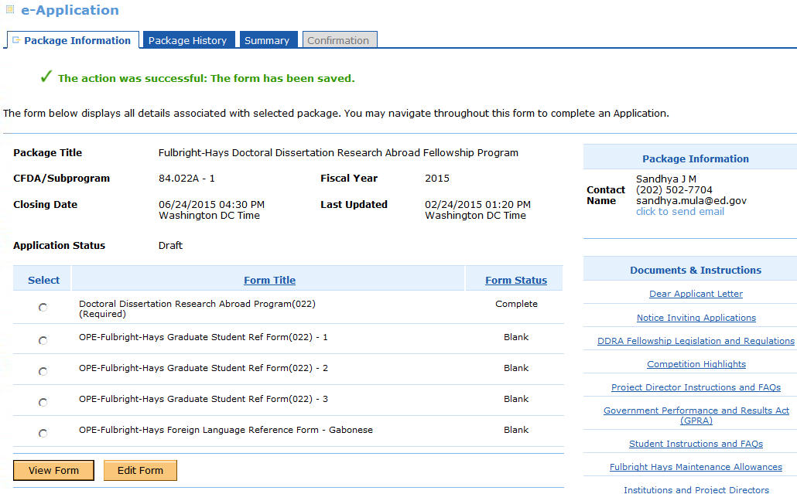
Once an applicant begins their application and completes the DDRA form, the Reference forms will automatically generate.

Slide 22
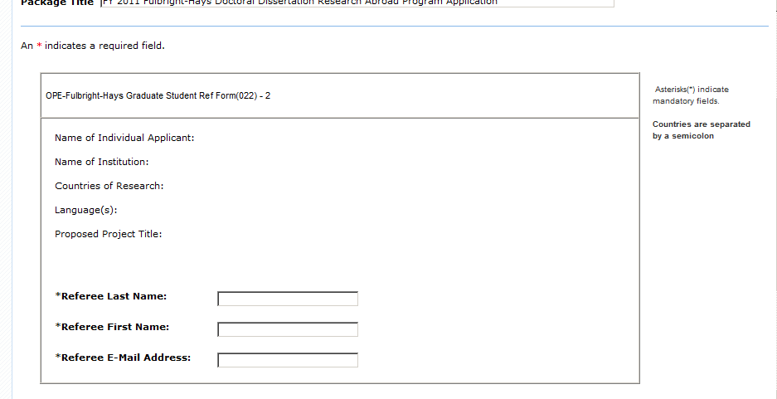
Below is a sample Referee form that the Fellow will need to complete to initiate the referral process. Upon completion the Referee will receive an email with a link which will allow him/her to complete a recommendation on behalf of the fellow. Be sure to verify that the email address of your referee is correct. G5 will send the referee request to the email address you input in this screen.

Slide 23
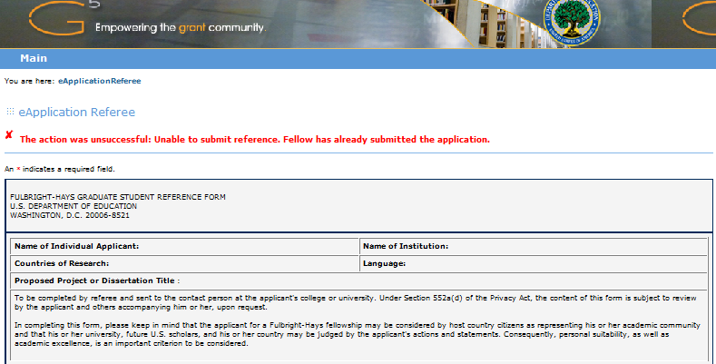
A referee CANNOT submit a referral if the Fellow or the Project Director have
submitted their application packages

Slide 24
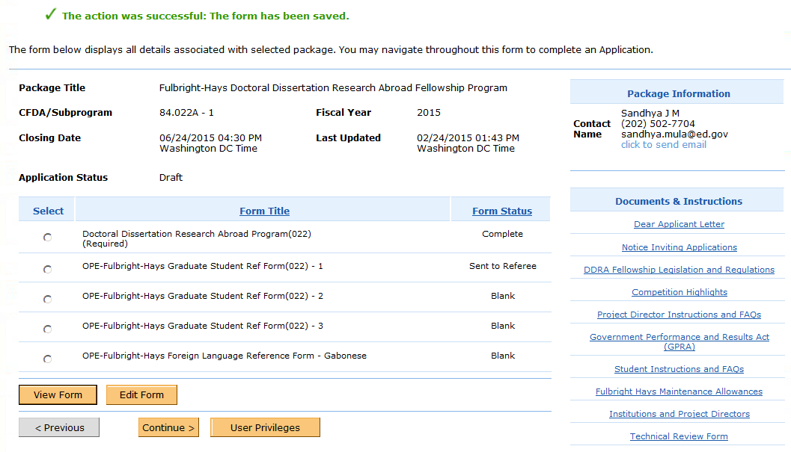
Once a Referee form has been sent, the status of the form will change to “Sent to Referee” as shown below. After the Reference form has completed and returned by the Referee, the status of the form will change to “Complete”.

Slide 25
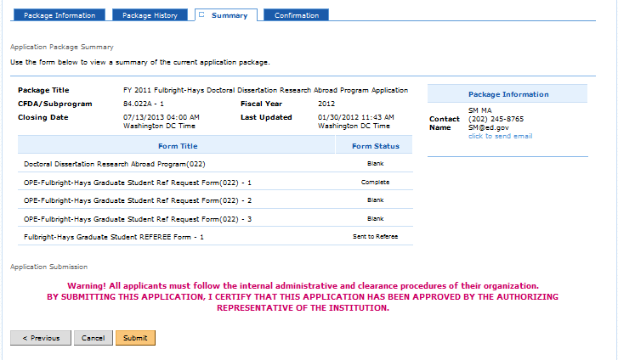
When the fellow tries to submit their package, they are prompted with a warning message shown below.

Slide 26
Helpful Hints
A Fellow cannot submit their application after the Project Director has submitted the institution’s application.
The Project director must first “unsubmit” the institution’s application if a fellow wants to “unsubmit” their application.
A referee cannot submit their recommendations if a fellow or project director has submitted their application.
The Project Director and the Applicant must be associated with the same institution in G5.

